Slide 1
Scribble and Distributed Systems

Slide 2
The evolution of enterprise systems
Point to Point, Bespoke clients, Deployment by domain
Server
Server
Client
Client
Server
Client
X2 for replicated servers x number of environments
X number of actual users for fat clients

Slide 3
The evolution of enterprise systems
Message Bus, Integrated client, Sharing through back end Message Bus,
Deployment by functional area within domain, SOA and ESB.
Server
Server
Server
Client
Server
Server
Server
X2 for replicated servers and X number of environments/shareable factor
X actual number of users for fat clients

Slide 4
The evolution of enterprise systems
μMicro-services and API’s, Message Bus and HTTP, JSON on the wire, Browser based clients, Incremental deployment based on bounded contexts,
Horizontally scalable, cloud execution venues
μ
μ
μ
μ
μ
μ
μ
μ
μ
μ
Client
μ
μ
μ
μ
μ
μ
μ
μ
μ
μ
μ
μ
μ
μ
μ
Pay by process at lower cost per mip, lower cost per message, lower cost for memory
X actual number of users for thin, browser based, clients mobile or otherwise

Slide 5
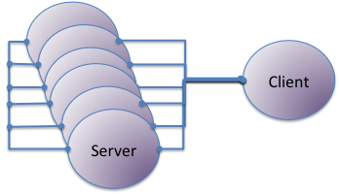
The evolution of enterprise systems
μMicro-services and API’s, Message Bus and HTTP, JSON on the wire, Browser based clients, Incremental deployment based on bounded contexts,
Horizontally scalable, cloud execution venues
μ
μ
μ
μ
μ
Client
Pay by process at lower cost per mip, lower cost per message, lower cost for memory
X actual number of users for thin, browser based, clients mobile or otherwise

Slide 6
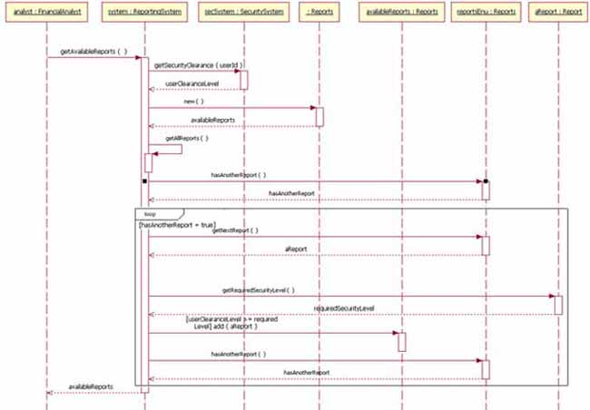
The evolution of enterprise systems – drill down …
μMicro-service deployed into SIT, other μMicro-service are stubbed based on a sequence diagram. Nothing enforces behaviour because none is captured in a form to do so. Dumb stubs.
μ
μ
μ
μ
μ
Client
Pay by process at lower cost per mip, lower cost per message, lower cost for memory
X actual number of users for thin, browser based, clients mobile or otherwise

Slide 7
The evolution of enterprise systems – drill down …
μMicro-service stubs are replaced by full implementations over time
μ
μ
μ
μ
μ
Client
Pay by process at lower cost per mip, lower cost per message, lower cost for memory
X actual number of users for thin, browser based, clients mobile or otherwise

Slide 8
The evolution of enterprise systems – drill down …
And it goes …..
μ
μ
μ
μ
μ
Client
Pay by process at lower cost per mip, lower cost per message, lower cost for memory
X actual number of users for thin, browser based, clients mobile or otherwise

Slide 9
The evolution of enterprise systems – drill down …
μ
μ
μ
μ
μ
Client
Pay by process at lower cost per mip, lower cost per message, lower cost for memory
X actual number of users for thin, browser based, clients mobile or otherwise

Slide 10
The evolution of enterprise systems – drill down …
Until we have the bounded context fully deployed with all business logic done.
μ
μ
μ
μ
μ
Client
Pay by process at lower cost per mip, lower cost per message, lower cost for memory
X actual number of users for thin, browser based, clients mobile or otherwise

Slide 11
The evolution of enterprise systems
μMicro-services and API’s, Message Bus and HTTP, JSON on the wire, Browser based clients, Incremental deployment based on bounded contexts,
Horizontally scalable, cloud execution venues
Shrinking old TCO and embracing the new model.
μ
μ
μ
μ
μ
μ
Client
μ
μ
μ
μ
Pay by process at lower cost per mip, lower cost per message, lower cost for memory
X actual number of users for thin, browser based, clients mobile or otherwise

Slide 12
The evolution of enterprise systems
μMicro-services and API’s, Message Bus and HTTP, JSON on the wire, Browser based clients, Incremental deployment based on bounded contexts,
Horizontally scalable, cloud execution venues
Much faster ability to change as dependencies decrease. . Ops costs dropping through DevOps/CDCI
μ
μ
μ
μ
μ
μ
μ
μ
μ
μ
Client
μ
μ
μ
μ
μ
Pay by process at lower cost per mip, lower cost per message, lower cost for memory
X actual number of users for thin, browser based, clients mobile or otherwise

Slide 13
The evolution of enterprise systems
μMicro-services and API’s, Message Bus and HTTP, JSON on the wire, Browser based clients, Incremental deployment based on bounded contexts,
Horizontally scalable, cloud execution venues
Stateless read services scale well. Still hard to get statefull done as fast. SIT testing faster but more complex with more chatter.
μ
μ
μ
μ
μ
μ
μ
μ
μ
μ
Client
μ
μ
μ
μ
μ
μ
μ
μ
μ
μ
Pay by process at lower cost per mip, lower cost per message, lower cost for memory
X actual number of users for thin, browser based, clients mobile or otherwise

Slide 14
The evolution of enterprise systems
μMicro-services and API’s, Message Bus and HTTP, JSON on the wire, Browser based clients, Incremental deployment based on bounded contexts,
Horizontally scalable, cloud execution venues
Velocity starts to tail off as complexity of chatter grows.
Hard to monitor at the business level.
μ
μ
μ
μ
μ
μ
μ
μ
μ
μ
Client
μ
μ
μ
μ
μ
μ
μ
μ
μ
μ
μ
μ
μ
μ
μ
Pay by process at lower cost per mip, lower cost per message, lower cost for memory
X actual number of users for thin, browser based, clients mobile or otherwise

Slide 15
The evolution of enterprise systems
μMicro-services and API’s, Message Bus and HTTP, JSON on the wire, Browser based clients, Incremental deployment based on bounded contexts,
Horizontally scalable, cloud execution venues
μ
μ
μ
μ
μ
Over time the number of processes is in the 1000’s. All of the services are instantiated and so you incur costs without any value associated to it.
μ
μ
μ
μ
μ
Client
μ
μ
μ
μ
μ
μ
μ
μ
μ
μ
μ
μ
μ
μ
μ
Pay by process at lower cost per mip, lower cost per message, lower cost for memory
X actual number of users for thin, browser based, clients mobile or otherwise

Slide 16
The evolution of enterprise systems
μMicro-services and API’s, Message Bus and HTTP, JSON on the wire, Browser based clients, Incremental deployment based on bounded contexts,
Horizontally scalable, cloud execution venues
μ
μ
μ
μ
μ
TCO is based on the total number of μMicro-services and is amortised over the value generating transactions.
μ
μ
μ
μ
μ
Client
μ
μ
μ
μ
μ
μ
μ
μ
μ
μ
μ
μ
μ
μ
μ
Pay by process at lower cost per mip, lower cost per message, lower cost for memory
X actual number of users for thin, browser based, clients mobile or otherwise

Slide 17


The evolution of enterprise systems
μMicro-services and API’s with HTTP and lighterweight IoT processes all chattering.
TCO is based on the total number of μMicro-services and is amortised over the value generating transactions.
Client
Ever more data from IoT

Slide 18
Scribble and μMicroservices
What if the TCO was based on the exact μMicro-services used in supporting a transaction? What if we could reduce the cost and pace of change?
This is what scribble could do.
Client

Slide 19
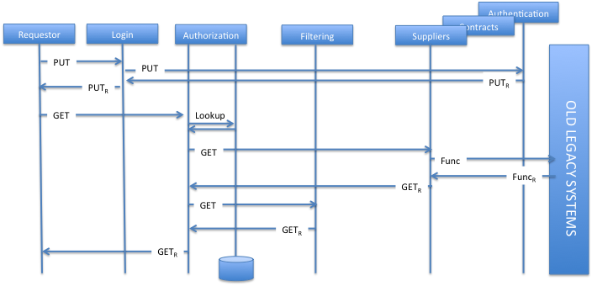
DEMO

Slide 20
curl -i --data "@Scribble.scr” {URL}:{PORT}{URI}/epp__protocolName__roleName
Client
HTTP/1.1 100 Continue
Content-Length: 0
HTTP/1.1 200 OK
Date: Fri, 10 Feb 2017 17:28:19 GMT
Content-length: 164
Instantiated FSM for role 'authorisersvc' based on 'PartnershipSuppliers' for /tescos/tps/auth/api at port 4545
Accepting:
<accept_connection__from_requestor >
HTTPSvr
Epp of Scribble.scr for roleName in protocolName
HTTPSvr
Server
Bringing up http server on port 4545 for url /tescos/tps/auth/api
/tescos/tps/auth/api
------- GOT REQUEST METHOD: POST-------
context path: /tescos/tps/auth/api
URI is </tescos/tps/auth/api/____eppLoad____PartnershipSuppliers____authorisersvc>
Event: eppLoad
Loading easyFSM role from scribble
Instatiating FSM for role 'authorisersvc' based on 'PartnershipSuppliers'
eppLoad ...
Got file /Users/stalbot/wip/projects/bin/generated/authorisersvc_config.txt
FSM Instantiating for role authorisersvc: current state is: <START_authorisersvc_65>
nextstate[0]: <accept_connection__from_requestor >
Accepting:
<accept_connection__from_requestor >
HTTPSvr for
roleName

Slide 21
curl -H "Content-Type: application/json" -X POST -d ’JSON’ {URL}:{PORT}{URI}/{NextState}
Client
☑
*** ACCEPTED ***
Current state is __accept_connection__from_requestor_DONE_67.
<receiveMessage(getcontracts())__from_requestor >
<receiveMessage(getsuppliers(uuid))__from_requestor >
Server
------- GOT REQUEST METHOD: POST-------
context path: /tescos/tps/auth/api
URI is </tescos/tps/auth/api/____accept_connection__from_requestor>
Event: accept
Trying to execute as an FSM in the role of authorisersvc with the message </tescos/tps/auth/api/____accept_connection__from_requestor>
xformed message is: accept_connection__from_requestor
FSMExecute(com.scribble.easyfsm.FSM.FSM@1ed22004,accept_connection__from_requestor)
current state before execution is: <START_authorisersvc_65>
nextstate[0]: <accept_connection__from_requestor >
current state after execution is: <__accept_connection__from_requestor_DONE_67>
nextstate[0]: <receiveMessage(getcontracts())__from_requestor >
nextstate[1]: <receiveMessage(getsuppliers(uuid))__from_requestor >
------- END REQUEST METHOD: POST-------
HTTPSvr for
roleName

Slide 22
curl -H "Content-Type: application/json" -X POST -d ’JSON’ {URL}:{PORT}{URI}/{NextState}
requestor vs requester
Client
*** ERROR ***
accept_connection__from_requester has no matching state transition. Current state is START_authorisersvc_65.
<accept_connection__from_requestor >
☒
Server
------- GOT REQUEST METHOD: POST-------
context path: /tescos/tps/auth/api
URI is </tescos/tps/auth/api/____accept_connection__from_requester>
Event: accept
Trying to execute as an FSM in the role of authorisersvc with the message </tescos/tps/auth/api/____accept_connection__from_requester>
xformed message is: accept_connection__from_requester
FSMExecute(com.scribble.easyfsm.FSM.FSM@716402cd,accept_connection__from_requester)
current state before execution is: <START_authorisersvc_65>
nextstate[0]: <accept_connection__from_requestor >
*** ERROR ***
accept_connection__from_requester has no matching state transition
------- END REQUEST METHOD: POST-------
HTTPSvr for
roleName

Slide 23
curl -H "Content-Type: application/json" -X POST -d ’JSON’ {URL}:{PORT}{URI}/{NextState}
JSON is of the form:
{
"function":”<functionName>",
"from|to":”<roleName>",
"parameters":
{
"param1":{”<pname>":”<pvalue>"},
"param2":{“<pname>":“<pvalue>"}
}
}

Slide 24
curl -H "Content-Type: application/json" -X POST -d ’JSON’ {URL}:{PORT}{URI}/{NextState}
This is how scribble sees it:
α!η ρ sends message to α called η
α?b ρ receives message from α called η
-/- ρ disconnect from α
α?? ρ accepts session request from α
α!! ρ requests connection to α
Where ρ is the executing role
For explicit protocols we have:
α!! ρ requests connection to α
α?? ρ accepts session request from α
Any number of
α!η ρ sends message to α called η
α?η ρ receives message from α called η
Before
-/- ρ disconnect from α

Slide 25
curl -H "Content-Type: application/json" -X POST -d ’JSON’ {URL}:{PORT}{URI}/{NextState}
For explicit protocols we now have:
απϕ ρ asks for an epp of ϕ to instantiate α
a channel to the new α is returned
α!! ρ requests connection to α
α?? ρ accepts session request from α
Any number of
α!η ρ sends message to α called η
α? η ρ receives message from α called η
Before
-/- ρ disconnect from α
Where ϕ is any scribble definition

Slide 26
απϕ => curl -i --data "@Scribble.scr” {URL}:{PORT}{URI}/epp__protocolName__roleName
α?? => curl -H "Content-Type: application/json" -X POST -d ’JSON’ {URL}:{PORT}{URI}/{NextState}
α!η => curl -H "Content-Type: application/json" -X POST -d ’JSON’ {URL}:{PORT}{URI}/{NextState}
α?η => curl -H "Content-Type: application/json" -X POST -d ’JSON’ {URL}:{PORT}{URI}/{NextState}
-/- => curl -H "Content-Type: application/json" -X POST -d ’JSON’ {URL}:{PORT}{URI}/{NextState}
απϕ
α!η
α?η
α??
-/-
HTTPSvr
HTTPSvr for
α
HTTPSvr for
α
HTTPSvr for
α
HTTPSvr for
α
…...
NextState is η
JSON represents any additional data to be passed as parameters for η
Ρ represents the invocation of curl

Slide 27
The curl
auth-test.sh
#/bin/sh
PORT=$1
URI=$2
curl -i --data "@SupplierManagement.scr" http://localhost:${PORT}${URI}/____eppLoad____PartnershipSuppliers____authorisersvc
sleep 1
curl -H "Content-Type: application/json" -X POST http://localhost:${PORT}${URI}/____accept_connection__from_requestor
sleep 1
curl -H "Content-Type: application/json" -X POST -d '{"function":"getsuppliers","from":"requestor","parameters":{"param1":{"uuid":"991"}}}' http://localhost:${PORT}${URI}/____receiveMessage
sleep 1
curl -H "Content-Type: application/json" -X POST http://localhost:${PORT}${URI}/____request_connection__to_suppliersvc
sleep 1
curl -H "Content-Type: application/json" -X POST -d '{"function":"getsuppliers","to":"suppliersvc"}' http://localhost:${PORT}${URI}/____sendMessage
sleep 1
curl -H "Content-Type: application/json" -X POST -d '{"function":"suppliers","from":"suppliersvc"}' http://localhost:${PORT}${URI}/____receiveMessage
sleep 1
curl -H "Content-Type: application/json" -X POST http://localhost:${PORT}${URI}/____request_connection__to_filtersvc
sleep 1
curl -H "Content-Type: application/json" -X POST -d '{"function":"filterSuppliers","to":"filtersvc","parameters":{"param1":{"usercontext":"somecontext"},"param2":{"filters":"somefiler"},"param3":{"supplierdetails":"somesupplierdetails"}}}' http://localhost:${PORT}${URI}/____sendMessage
sleep 1
curl -H "Content-Type: application/json" -X POST -d '{"function":"filtered","from":"filtersvc"}' http://localhost:${PORT}${URI}/____receiveMessage

Slide 28
The curl
Client
Instantiated FSM for role 'authorisersvc' based on 'PartnershipSuppliers' for /tescos/tps/auth/api at port 4545
*** ACCEPTED ***
Current state is __accept_connection__from_requestor_DONE_67.
<accept_connection__from_requestor >
<receiveMessage(getcontracts())__from_requestor >
<receiveMessage(getsuppliers(uuid))__from_requestor >
*** ACCEPTED ***
Current state is __receiveMessage(getsuppliers(uuid))__from_requestor_DONE_68.
<request_connection__to_suppliersvc >
<sendMessage(deny())__to_requestor >
*** ACCEPTED ***
Current state is __request_connection__to_suppliersvc_DONE_69.
<request_connection__to_suppliersvc >
<sendMessage(deny())__to_requestor >
<sendMessage(getsuppliers())__to_suppliersvc >
*** ACCEPTED ***
Current state is __sendMessage(getsuppliers())__to_suppliersvc_DONE_70.
<receiveMessage(suppliers())__from_suppliersvc >
*** ACCEPTED ***
Current state is __receiveMessage(suppliers())__from_suppliersvc_DONE_71.
<request_connection__to_filtersvc >
*** ACCEPTED ***
Current state is __request_connection__to_filtersvc_DONE_72.
<request_connection__to_filtersvc >
<sendMessage(filterSuppliers(usercontext, filters, supplierdetails))__to_filtersvc >
*** ACCEPTED ***

Slide 29
The curl
Client
Current state is __sendMessage(filterSuppliers(usercontext, filters, supplierdetails))__to_filtersvc_DONE_73.
<receiveMessage(filtered())__from_filtersvc >
*** ACCEPTED ***
Current state is __receiveMessage(filtered())__from_filtersvc_DONE_74.
<request_disconnection__from_filtersvc >
*** ACCEPTED ***
Current state is __request_disconnection__from_filtersvc_DONE_75.
<request_disconnection__from_filtersvc >
<request_disconnection__from_suppliersvc >
*** ACCEPTED ***
Current state is __request_disconnection__from_suppliersvc_DONE_76.
<request_disconnection__from_suppliersvc >
<sendMessage(suppliers())__to_requestor >
*** ACCEPTED ***
Current state is __accept_connection__from_requestor_DONE_67.
<receiveMessage(getcontracts())__from_requestor >
<receiveMessage(getsuppliers(uuid))__from_requestor >

Slide 30
The http server
Server
./fsm-server.sh 4545 /tescos/tps/auth/api
Bringing up http server on port 4545 for url /tescos/tps/auth/api
/tescos/tps/auth/api
------- GOT REQUEST METHOD: POST-------
context path: /tescos/tps/auth/api
URI is </tescos/tps/auth/api/____eppLoad____PartnershipSuppliers____authorisersvc>
Event: eppLoad
Loading easyFSM role from scribble
Instatiating FSM for role 'authorisersvc' based on 'PartnershipSuppliers'
eppLoad ...
Got file /Users/stalbot/wip/projects/bin/generated/authorisersvc_config.txt
FSM Instantiating for role authorisersvc: current state is: <START_authorisersvc_65>
nextstate[0]: <accept_connection__from_requestor >
------- END REQUEST METHOD: POST-------
------- GOT REQUEST METHOD: POST-------
context path: /tescos/tps/auth/api
URI is </tescos/tps/auth/api/____accept_connection__from_requestor>
Event: accept
Trying to execute as an FSM in the role of authorisersvc with the message </tescos/tps/auth/api/____accept_connection__from_requestor>
xformed message is: accept_connection__from_requestor
FSMExecute(com.scribble.easyfsm.FSM.FSM@61790038,accept_connection__from_requestor)
current state before execution is: <START_authorisersvc_65>
nextstate[0]: <accept_connection__from_requestor >
current state after execution is: <__accept_connection__from_requestor_DONE_67>
nextstate[0]: <receiveMessage(getcontracts())__from_requestor >
nextstate[1]: <receiveMessage(getsuppliers(uuid))__from_requestor >
------- END REQUEST METHOD: POST-------

